Slide 1


Biography
Philip Mason
Philip Mason has been a SAS programmer for 39 years, having spent 29 years as an independent SAS Consultant. Starting in Australia he then moved on to Europe working in Belgium, Netherlands and the U.K. where he is now based. He has written 3 books about SAS, and also written several SAS courses, founded some user groups, helped run Pharmasug, SAS Global Forum, VIEWS, SMUG, and so on.
He currently works with SAS and JavaScript, helping a bio-tech called argenx in Ghent, Belgium.
Phil’s wife is a Baptist minister, his eldest is a SAS programmer, daughter is a fashion industry merchandising manager and youngest just completed their Master of Maths at Emmanuel College Cambridge University.

Slide 2
Analyzing your SAS log with user defined rules using an app or macro.
And the benefits this provides

Slide 3
Approach

Slide 4
What do we want from log analysis
What do we want?
How do we get it?
Give me more than SAS does
Fast
Consistent source of truth
Analyze and find what I want
Run in batch or use interactively
Integrate with linking to it and from it
Define each thing to look for
Implement code to use those rules to analyze log
Do this in SAS
Do this in JavaScript
Build a web application to provide interactive interface to results
Notes:
Integrated – can link to it, pass parms in, go to a line

Slide 5
Defining Rules
A way to represent what to look for in a log

Slide 6
Simple rule to find Notes
"startswith": "NOTE:",
"prefix": "<span style='color: blue'>",
"suffix": "</span>",
"anchor": false,
"linkColor": "blue",
"type": "NOTE",
NOTE: Copyright (c) 2002-2012 by SAS Institute Inc., Cary, NC, USA.
<span style='color: blue’> NOTE: Copyright (c) 2002-2012 by SAS Institute Inc., Cary, NC, USA. </span>
NOTE: Copyright (c) 2002-2012 by SAS Institute Inc., Cary, NC, USA.

Slide 7
Rule properties
Property | Description
ruleType | “regex” indicates this rule uses a regular expression to search text “startsWith” indicates this rule will simply check if a line starts with some text
startswith | Text used in searching line to see if that line starts with this
regex | Regular expression used to search line. Basic use is simply to see if a line matches. You can use capture groups which can be used in some more advanced instances.
prefix | Text (usually HTML code) that will be added to the beginning of line before it is displayed. Usually, you can use a <span> tag with some formatting in style= to change colours, fonts, etc.
suffix | Text (usually HTML code) that will be added to the end of line before it is displayed.
anchor | True will display line as a clickable link in the “contents” area of log viewer. False won't display a link, but in the HTML of the log displayed there will be an id= tag with a unique reference, so that the line can be linked to from other functionality such as the input/output tables.
linkColor | Defines an HTML colour to use for links in the “contents” area

Slide 8
Rule properties
Property | Description
type | Defines text to categorise rule as, e.g. “ERROR”. You can create any categories, and checkboxes will appear for each category along with a count of how many lines match. null can be used as a value, which will not produce any category checkbox.
interesting | true means that you can use the next/previous interesting thing arrows in the viewer for this line, allowing grouping of the things you are most interested in false means this is not interesting
description | Description of this rule, useful as documentation and to help others especially if you are using more complex regular expressions
substitute | false does nothing true will do the following: 1 - use the regular expression to capture the text that matches 2 – replace {{matched}} in prefix and suffix with the matching text e.g. find URLs in the log and convert them into clickable links to those URLs

Slide 9
A rule to find Warnings
"ruleType": "regex",
"regex": "(?:^WARNING:|^WARNING\\s)(?!.*PRODUCT WITH WHICH|.*PRODUCT WITH WHICH|.*IS ASSOCIATED WILL EXPIRE|.*MPRINT|.*MLOGIC|.*SYMBOLGEN|.*IS ASSOCIATED IS SCHEDULED TO EXPIRE|.*YOUR SYSTEM IS SCHEDULED TO EXPIRE)",
"prefix": "<span style='color: green'>",
"suffix": "</span>",
"anchor": true,
"linkColor": "green",
"type": "WARN",

Slide 10
More complex rule making links to URLs
{
"description": "Look for paths to a file or directory starting with http. Then create a link to it.",
"ruleType": "regex",
"regex": "http[s]?\\:[\\/\\w+|\\-|.]*",
"prefix": "<a href='{{matched}}' target='_blank'>",
"suffix": "{{matched}}</a>",
"anchor": false,
"linkColor": "blue",
"type": "FILE",
"interesting": false,
"substitute": true
}
Notes:
Complex – coming to macro soon, in new version of tool already

Slide 11
Defining special rules files
You can have many rules JSON files
They can be selected in macro call or from web application allowing:
Simple check of log with cut down version of rules
Looking for specific text in a log
Analysing any text file, such as other logs
Notes:
Can look through any text file for anything

Slide 12
Using Rules with a macro
Analyze log with a macro call to produce a report

Slide 13
Requirements for macro
What rules and log to use?
Types of rules to return? e.g. just Errors? Warnings?
Produce a dataset with results
Macro variable with result of scan
e.g. Pass or Fail

Slide 14
fileCheckWithRules parameters
Parameter | Description
log | location of text file (log) that will be analysed. If you specify pcsas then it will grab the log if running on PC SAS
rules | location of JSON file containing rule definitions. By default uses file from logviewer directory.
returnTypes | List of pipe separated quoted types to return, e.g. ERROR|WARN If blank, then everything found is returned.
print | 0, produces no report, but does set macro variables and creates a dataset 1, also produces a report
outputName | Optionally override the name of dataset that is created
Notes:
Link to star documentation

Slide 15
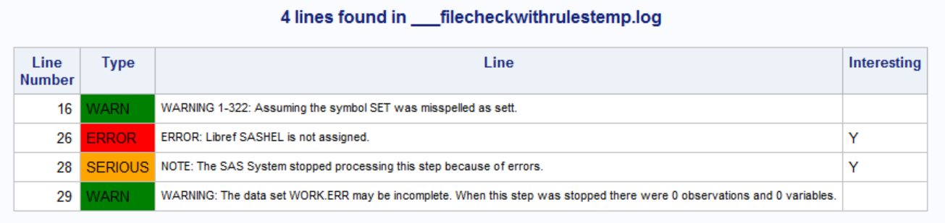
What is returned by fileCheckWithRules
Dataset is created containing results - fileCheckWithRules
Macro variable returned with the number of rows in dataset
Allows checking in a program if anything was found
HTML report is generated

Slide 16
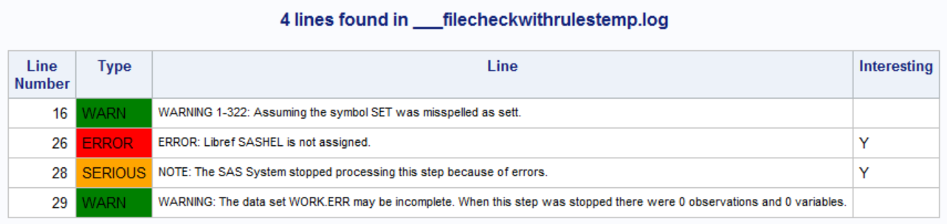
PC SAS example 1
dm 'log;clear';
data ok; set sashelp.class ; run ;
data warn ; sett sashelp.class ; run ;
data err ; set sashel.class ; run;
%filecheckwithrules(pcsas,rules=C:\github\logviewer\src\rules.json,print=1)
Notes:
dm 'log;clear';
data ok; set sashelp.class ; run ;
data warn ; sett sashelp.class ; run ;
data err ; set sashel.class ; run;
%filecheckwithrules(pcsas,rules=C:\github\logviewer\src\rules.json,print=1)

Slide 17
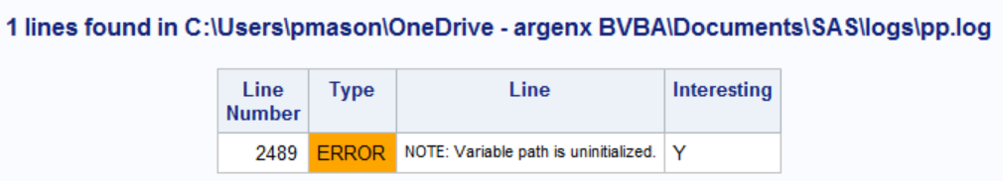
PC SAS example 2
%filecheckwithrules(C:\Users\pmason\SAS\logs\pp.log,
rules=C:\github\logviewer\src\rules.json,
print=1)
Notes:
%filecheckwithrules(C:\Users\pmason\OneDrive - argenx BVBA\Documents\SAS\logs\pp.log,
rules=C:\github\logviewer\src\rules.json,
print=1)

Slide 18
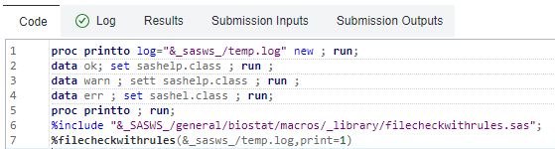
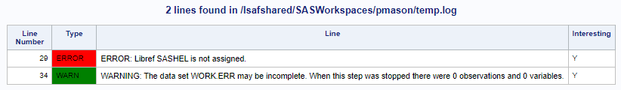
LSAF example
Notes:
proc printto log="&_sasws_/temp.log" new ; run;
data ok; set sashelp.class ; run ;
data warn ; sett sashelp.class ; run ;
data err ; set sashel.class ; run;
proc printto ; run;
%include "&_SASWS_/general/biostat/macros/_library/filecheckwithrules.sas";
%filecheckwithrules(&_sasws_/temp.log,print=1)

Slide 19
Using Rules with Web Application

Slide 20
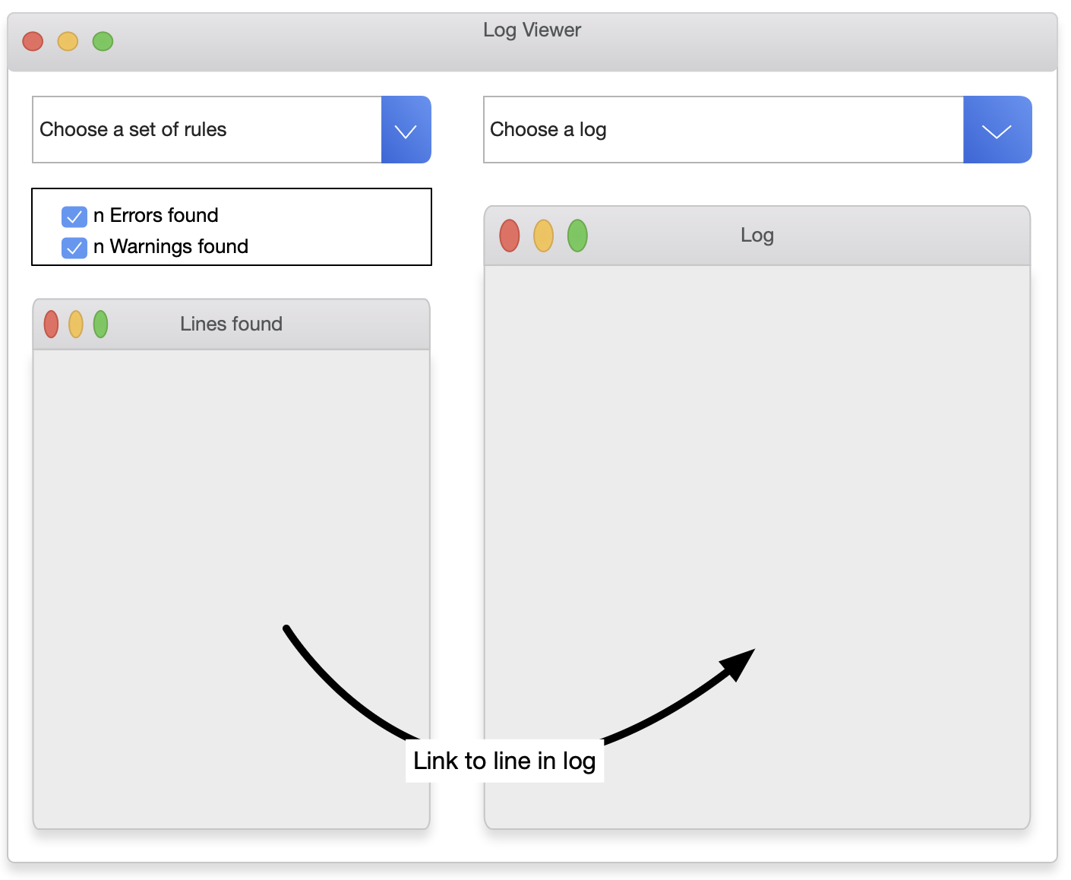
Log Viewer Web Application
Requirements
Wireframe
Select rules and log to analyze
Display log with styles applied
Summarize results of analysis
Jump from summary to related point in log
Nice to haves
Performance info
Macros used
Turn off mprint lines (reduce clutter)

Slide 21
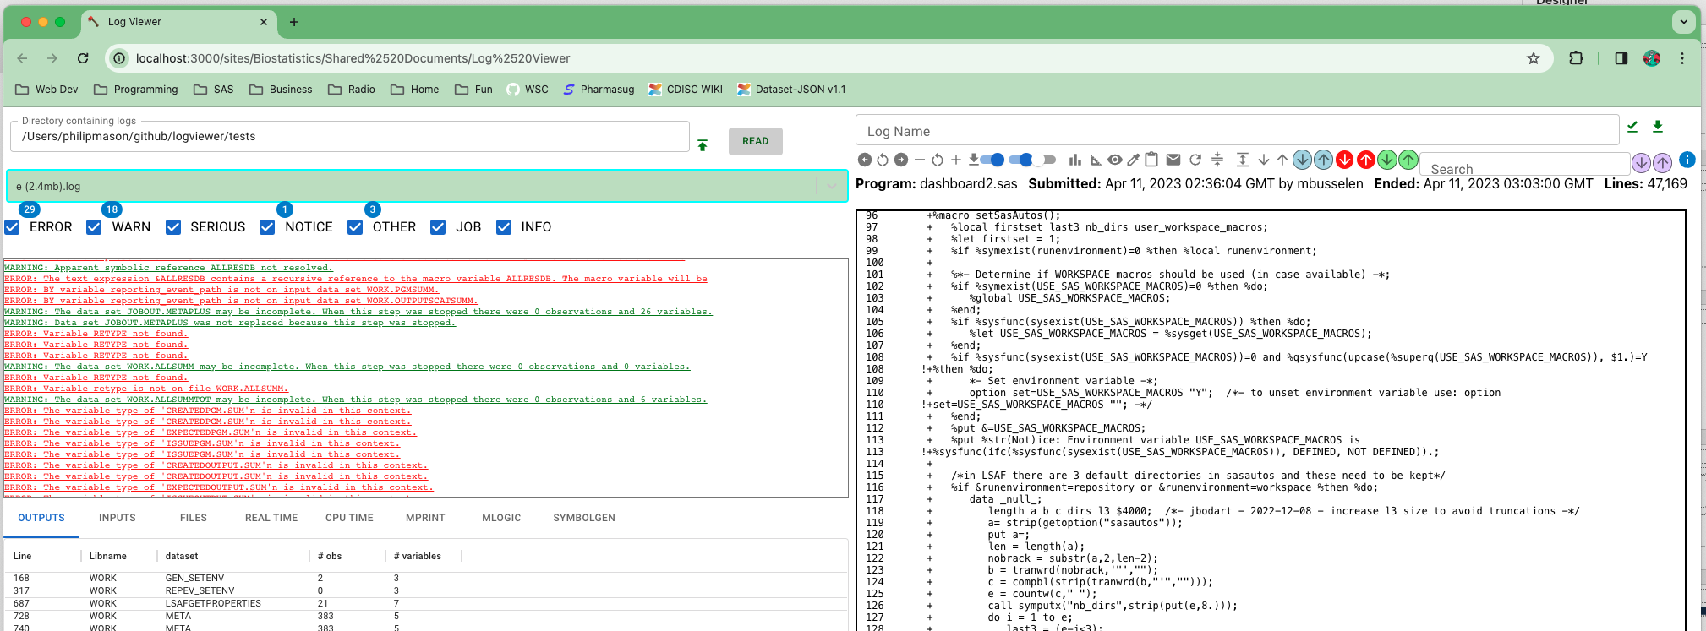
Log Viewer Web app

Slide 22
Resize panels
Resize fonts
Show/Hide
Source code
Macro lines
Line numbers
Data Flow Diagram
Choose/View rules
Copy source code
Paste a log
Email about this log
Refresh
Resize manually
Next/Previous
Page
Interesting thing
Error
Warning
Search, find next/previous
Info & Documentation

Slide 23
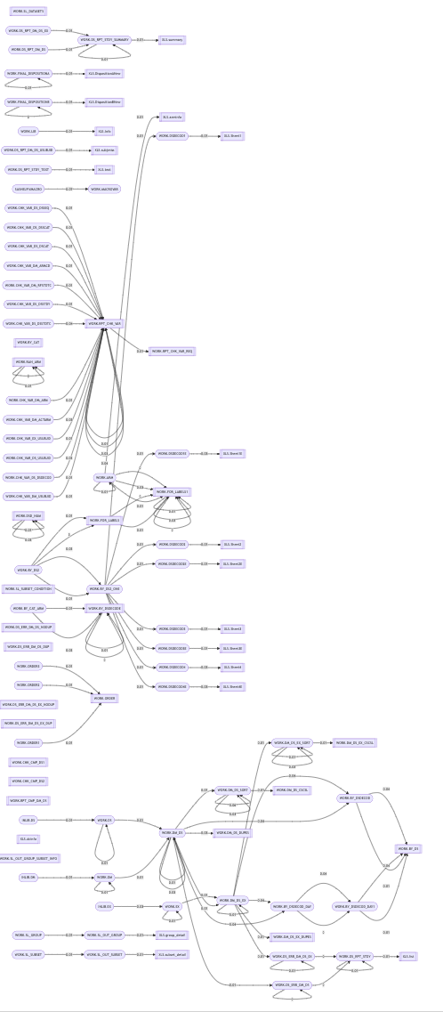
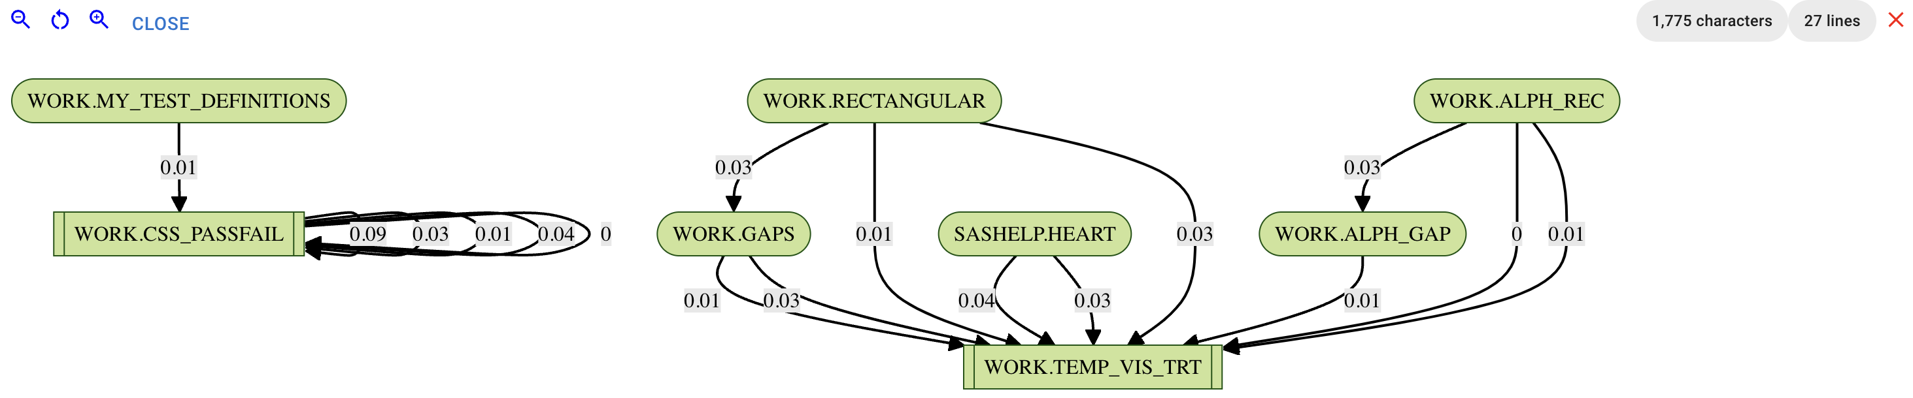
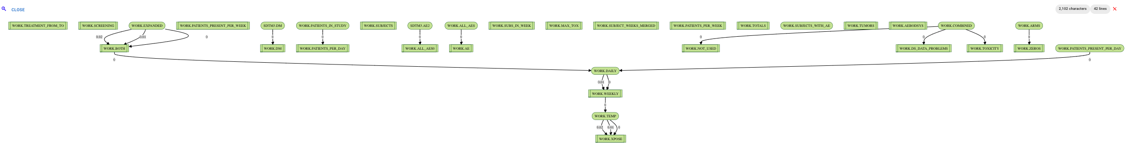
Example Data Flow Diagrams

Slide 24
Futures
See me if you would like to look at the Log Viewer

Slide 25
Many enhancements are planned/done
Bookmarklet to automate from LSAF
Tool definition to automate from PC SAS
Bookmarklet to automate from SAS Studio
VS Code extension
Electron version making native Linux, Windows & Mac applications
Creating reports on log analysis for PDF and Word
Improve integration with other SAS clients: EG, Studio, Viya
Rules to support R & Python
Integrate search into links on left panel
Generalise bottom left logic to work with anything, e.g. R log stats

Slide 26
Philip Mason
Wood Street Consultants Ltd.
Argenx (bio-tech based in Belgium)
+44 7465 748624‬
phil@woodstreet.org.uk
https://github.com/philipmason/Wood-Street-Consultants
https://www.linkedin.com/in/philmason/

